Slide 1
Mobility of CU students and employees: Commuting survey

Slide 2
Survey - outline
Online survey on the choice of transport mode for commuting to study
Data collection: October 21 – November 25, 2024
Recruitment:
Students – quota sampling of contacted individuals (n = 9,876)
Employees – blanket outreach Survey duration: 25.8 minutes (median) Response rate: 13.4% (students)
Part of Action Plan for the Implementation of the CU Sustainable Development Strategy: On the Road to Sustainability 2030
Research objectives:
to identify the current transport behaviour of employees and students at CU
to assess the willingness to change transport mode among respondents who commute by car
to identify motivations, barriers, and basic socioeconomic characteristics of respondents

Slide 3
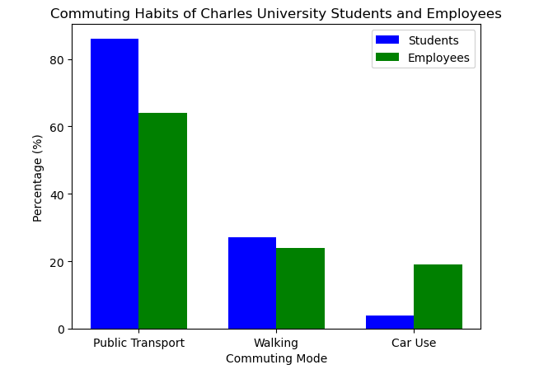
Travel Habits of CU Students and Staff
Key insights:
Public Transport: 86% of students vs. 64% of employees
Walking: 27% of students vs. 24% of employees
Car Use: 4% of students vs. 19% of employees
55% of employees commute 5+ times per week — 19 percentage points more than students.
General population survey: PT 38%, walking 35 %, car 66%

Slide 4
Car and Bicycle Ownership 🚗🚲
🧑‍💼 Employees
Over half of households (52%) own one car; 20% do not own a car at all
Bicycle ownership is evenly distributed; like cars, one-fifth of households do not own a bicycle
88% of employees hold a driver’s license
👩‍🎓 Students
31% of student households own one car; 24% do not own a car
Bicycle ownership is balanced; one-quarter of student households do not own a bicycle
77% of students have a driver’s license — 11 percentage points less than employees
General population survey: car ownership 96%, drivers‘ license 94%

Slide 5
Use of Shared and Public Transport Options
Students are more likely than employees to use:
Shared bikes 🚲
E-scooters 🛴
Car-sharing services 🚗
Alternative taxi services 🚖
🚋 Public Transport is Widely Used
Among employees, 70% have a public transport pass — 90% of them use an annual pass
Among students, the share is even higher: 82% have a pass, with 76% using an annual one
General population survey: public transport pass 39%

Slide 6
Awareness and Availability of Parking at CU
🚲 Many students are unaware of bicycle parking options
69% of students do not know whether they can park a bicycle at CU
Among employees, this is 42%
🚗 Most students do not have access to car parking
83% of students lack a designated parking space
Compared to 47% of employees

Slide 7
Travel Diary: Student Trip Purposes 🎓🏠🛍️
The most common purpose of students’ first trip is study (80.6%)
11% of students reported work as the purpose of their first trip
Less than 2% of first trips are for leisure activities
The most common purpose of the second trip is returning home (44.7%)
20.5% of second trips are for study
Shopping/services and leisure activities are tied for third and fourth place, each at 8.3%

Slide 8
Travel Diary: Employee Trip Purposes 👔🏠👶
In 86% of cases, employees’ first trip is to work
The second most common purpose of the first trip is accompanying a child to school/kindergarten (6.3%)
The most common purpose of the second trip is returning home (43.6%)
Other second trip purposes include work (22.2%) and shopping/services (8.3%)

Slide 9
Average Travel Time of Students by Mode of Transport 📚🚌
The fastest modes include public transport (metro, tram, bus, trolleybus): 13–16 minutes
Cycling takes students an average of 15 minutes, and walking takes 18 minutes
Driving (own car or carsharing) takes about 26–27 minutes, while carpooling takes around 32 minutes
Students spend the most time traveling by train (average 62 minutes) and long-distance bus (85 minutes)

Slide 10
Average Travel Time of Employees by Mode of Transport 💼🚗
Compared to students, employees have shorter walking trips (12 min), longer cycling trips (22 min), and do not use carsharing
Employees travel by car for an average of 22 minutes as passengers and 24 minutes as drivers
The fastest modes for employees are public transport (metro, tram, bus, trolleybus) and walking: 12–14 minutes
Like students, employees spend the most time traveling by train (40 min) and long-distance bus (56 min)

Slide 11
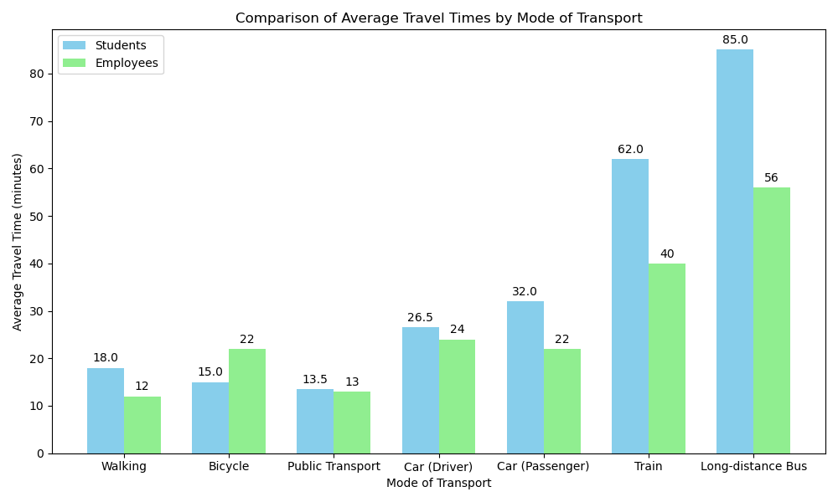

Slide 12
📏 Comparison of Average Travel Distances
Employees travel on average 1 kilometer less (14.2 km) than students (15.5 km)
This difference is based on the actual weighted average of all reported trips
However, the difference is not statistically significant

Slide 13
Perception vs. Preference: Public Transport Use
Students perceive public transport as dirtier than employees: Only 11% of students say it is rarely dirty, compared to 20% of employees
Despite this, students prefer public transport more often: 74% of students prefer it vs. 64% of employees
Planned use this semester:
86% of students intend to use public transport to commute to CU
Compared to 69% of employees
These intentions align with current usage patterns
General population survey: rarely dirty: 23%; planned PT use: 24%

Slide 14
Attitudes Toward Cycling During the Semester
➕ Perceived Benefits
Both students and employees agree that regular cycling provides sufficient physical activity (65%)
More than half of employees (51%) — and 1 percentage point more students — believe that cycling helps reduce environmental pollution 🌱
➖ Perceived Drawbacks
Concerns about sweating are more common among students (72%) than employees (69%)
Cycling is not seen as time-saving compared to other transport modes
69% of employees and 67% of students share this view ⏳
General population survey: sufficient physical activity: 73%; reduced envi pollution: 62%; sweating: 77%; no time-saving: 65%

Slide 15
Impact of Frequent Car Use 🚗 on the Environment 🌍
Most employees (65%) and students (70%) agree or strongly agree that frequent car use for commuting to CU this semester increases environmental pollution
In contrast, only 17% of employees and 9% of students believe that frequent car use would expose them to polluted air
General population survey: increased envi pollution: 56%; polluted air exposure: 20%

Slide 16
How to Improve Integration of Cycling and Public Transport for Commuting to CU? 🚴‍♂️🚌
✅ Cycling Infrastructure
The most helpful improvement for enabling regular cycling to CU would be building more bike paths to university buildings
49% of employees and 57% of students agree or strongly agree with this
✅ Faster and More Reliable Public Transport
44% of employees say that faster connections would most encourage them to prefer public transport
60% of students believe that more punctual services would lead to more frequent use of public transport

Slide 17
Is a Car Essential for Everyday Mobility? 🚗❌
Many students can easily imagine life without a car — 46% agree or strongly agree with this statement
Among employees, the share is 14 percentage points lower
In contrast, 15% of employees say they could not organize their daily life without a car
General population: 35% can and 49% cannot imagine life without car

Slide 18
Key Measures to Reduce Car Use for Commuting to CU 🚗📉
👩‍🎓 Students:
Improving access to public transport would contribute the most to reducing car trips, according to 58% of students
👨‍💼 Employees:
More frequent opportunities to work from home would help reduce car commuting the most, supported by 39% of respondents

Slide 19
Sociodemographic Characteristics of Respondents
📌 11% of students reported working full-time alongside their studies 💼
📌 23% of employees have been at the university for 20 years or more ⌛
📌 38% of students do not work during their studies 🔧
📌 65% of employees currently work full-time or more 📅
📌 83% of employees have a university degree 🎓

Slide 20
Housing Situation of Employees and Students 🏠
🧑‍💼 Employees Mostly Own Their Homes
69% live in owner-occupied housing
25% live in rented accommodation
Only 1% live in university dormitories
👩‍🎓 Students Have More Diverse Housing
The most common arrangement: rented housing (35%)
Second most common: living with relatives or friends (29%)
23% live in owner-occupied housing
10% live in dormitories

Slide 21
Income of respondents💰
🧑‍💼 Employees
Most common net monthly income: 30,001 – 38,000 CZK (19%)
Only 10% earn more than 66,000 CZK
17% did not disclose their income
👩‍🎓 Students
Most common income: less than 10,000 CZK (35%)
13% of students have no income
9% did not disclose their income

Slide 22
Detailed report from the survey …

